Slide 1
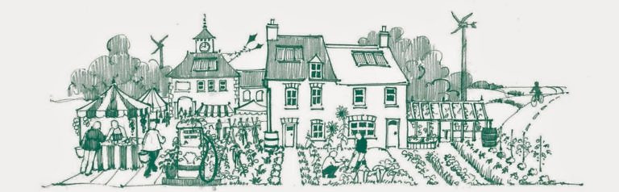
Transition Black Isle AGM October 2024
Convenor’s Report; Anne Thomas and Rose Grant
The Transition Movement invites us to reimagine and bring to life
a new story about how we live as members of the Earth family.
Using less - respecting more

Slide 2
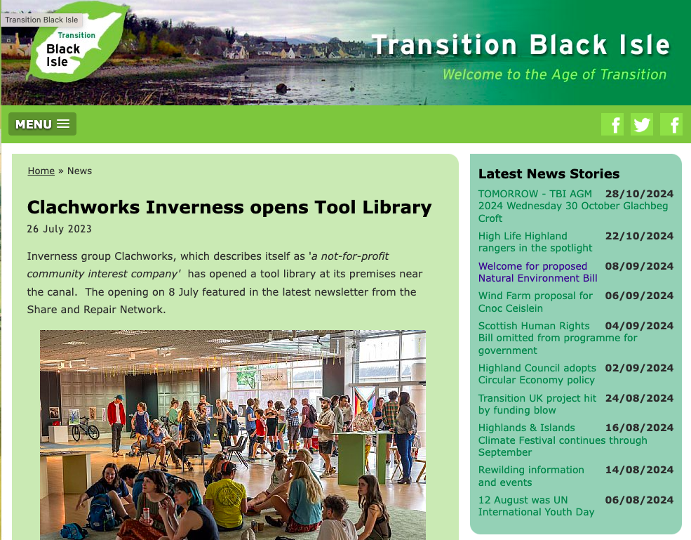
Promoting the message
Thanks to Peter Moffatt, Rose Grant and Anne Thomas
Newsletters – Editor Anne Thomas with Laura Donnelly and Lyn MacLardy responsible for HCWP content
Website - Manager: Peter Moffatt, update to new website with Rose Grant- updated with editorials and recent news and newsletters from across Scotland

Slide 3

Promoting the message
through revamping the website
Work in progress
Thanks to Peter Moffatt, Rose Grant and Plexus Media

Slide 4
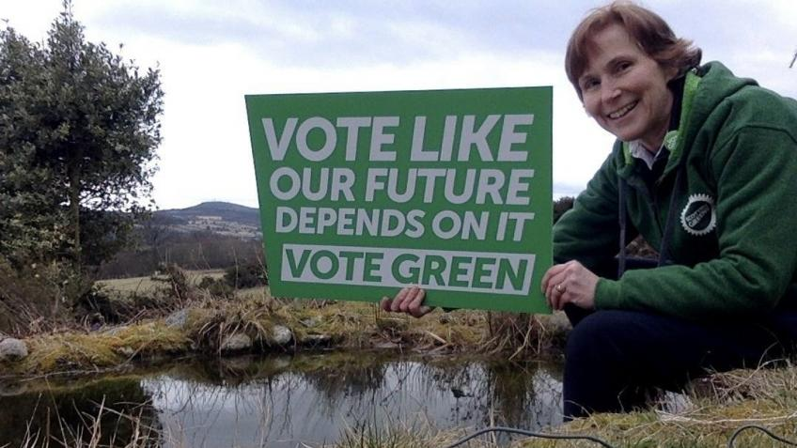
Promoting the message
through political activity
Anne Thomas stood in the General election this year,

Slide 5
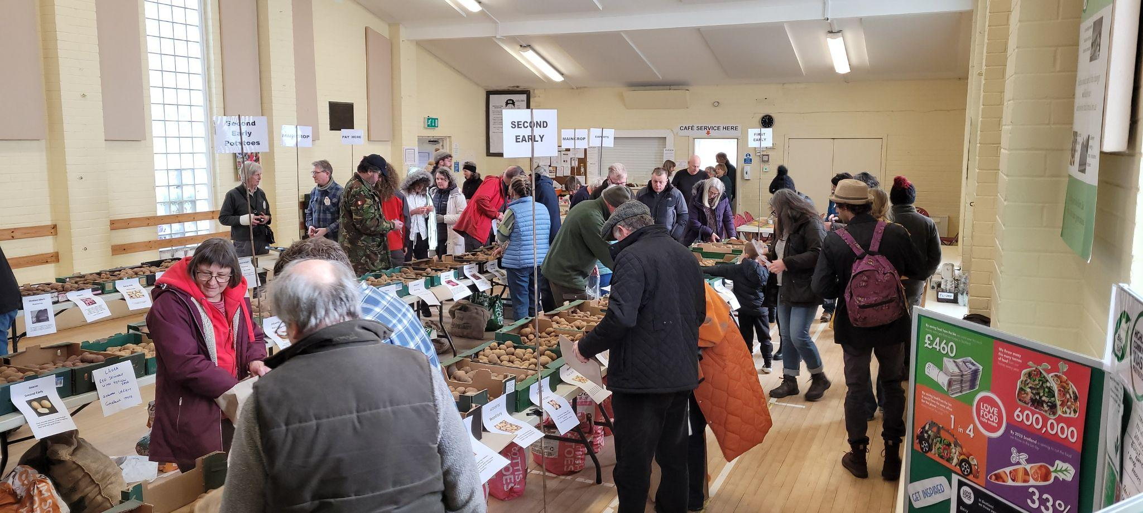
Promoting the message
Community Markets, Potato Day,
Climate Cafes and Repair Cafes and
Black Isle Gathering
For BIG, thanks to all those involved in all these activities
es Highland Community Waste Partnership, TBI and the Black Isle Men’s Shed

Slide 6
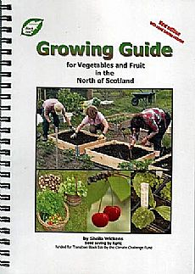
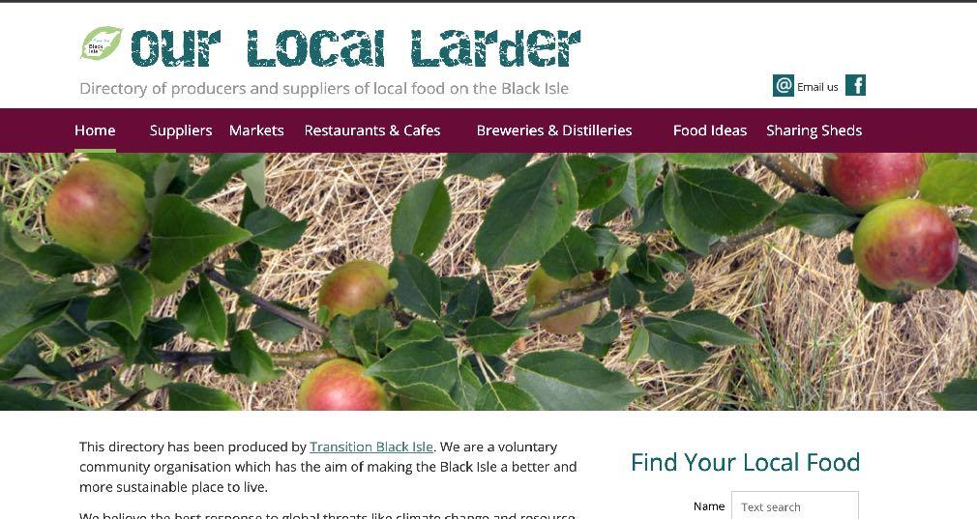
Promoting the message
Books and on-line publications
Both reference guides are in demand
Notes:
Our Growing Guide is onto its 3rd reprint and still selling. Our local larder has been super-ceded by a website which enables us to keep information up to date. Black Isle active travel map now 3rd edition.

Slide 7
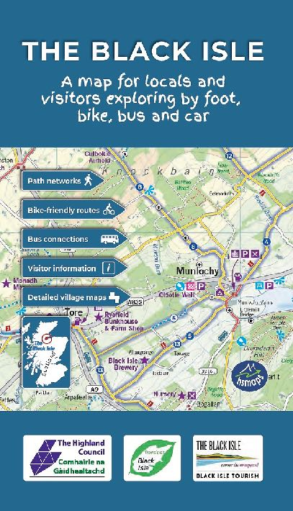
Promoting the message
Black Isle Map
TBI’s Active Travel Map
Highland Council funded through Black Isle Tourism
Stock running low. May need a fifth edition soon
Fourth Edition
Notes:
Our Growing Guide is onto its 3rd reprint and stocks running low. Our local larder has been super-ceded by a website which enables us to keep information up to date. Black Isle active travel map fourth edition funded by Highland Council

Slide 8
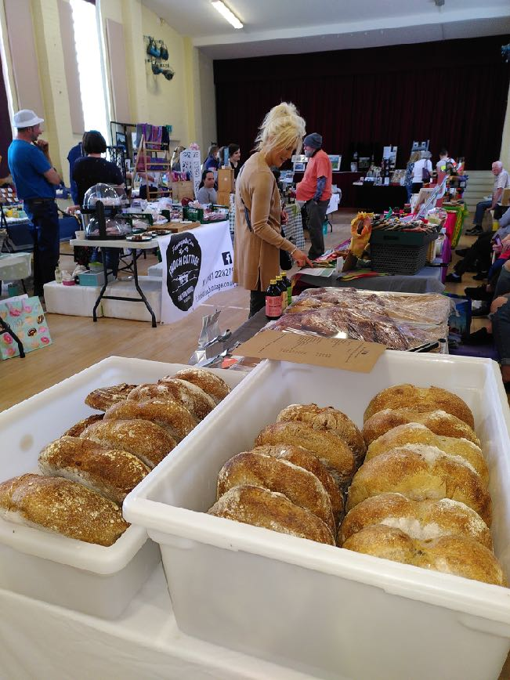
TBI Community Markets
TBI’s monthly indoor markets are both continuing at Cromarty and North Kessock
Each market provides an arena for TBI to advertise and interact with the community
Thank you to the TBI leaders and market organisers
The Culbokie Community Trust run a monthly market so three Saturdays a month are community market days.
Notes:
Were every Sat in the month (except 5 week month) there is a market somewhere on the BI encouraging the buying of local produce and crafts. Since lock down 2 shorter weekly outdoor markets supported but not directly organised by us.

Slide 9
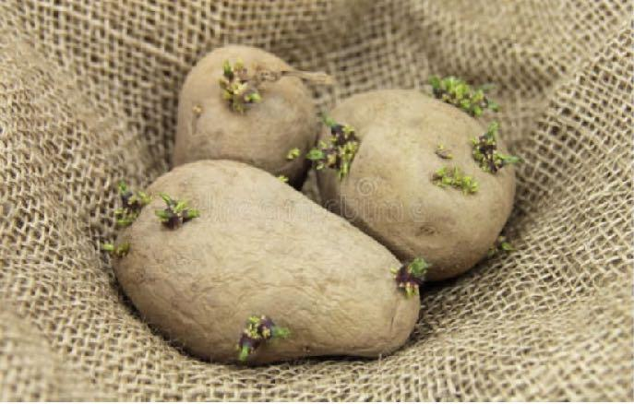
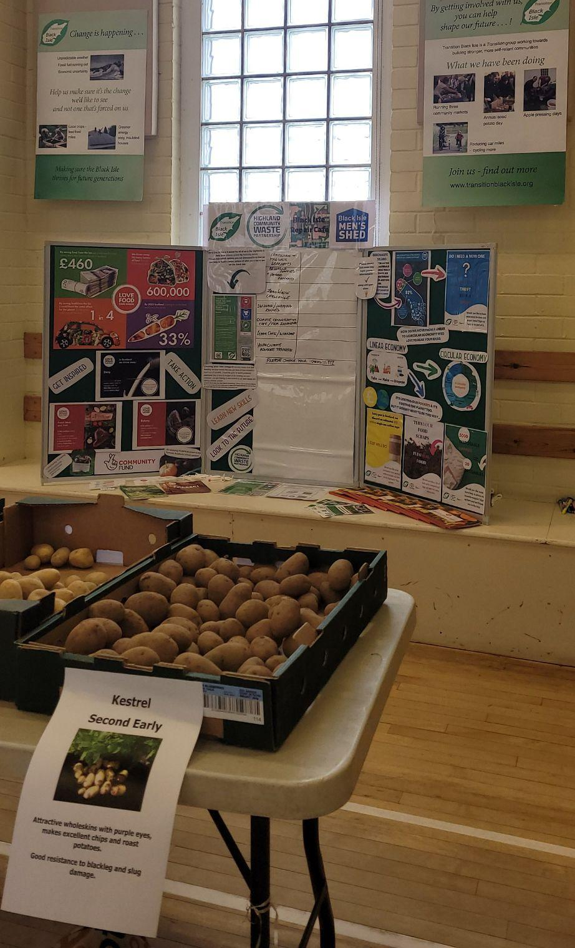
Return of Potato day
Potato Day returned to North Kessock and about 500 people attended despite Inverness holding its own first Potato day and others continuing at Drumnadrochit and Forres. £4000 profit, so is an important way to raise revenue for core costs

Slide 10
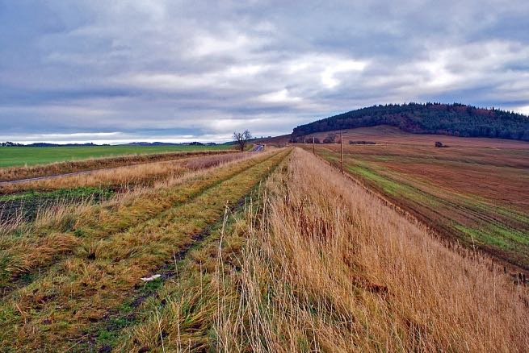
Avoch to Munlochy
Multipurpose Path
A design was produced, with some work to do to complete stage 2.
Highland Council took over as lead partner
Some landowner consultation complete, but funding gap this year has lead to a pause in activity.

Slide 11
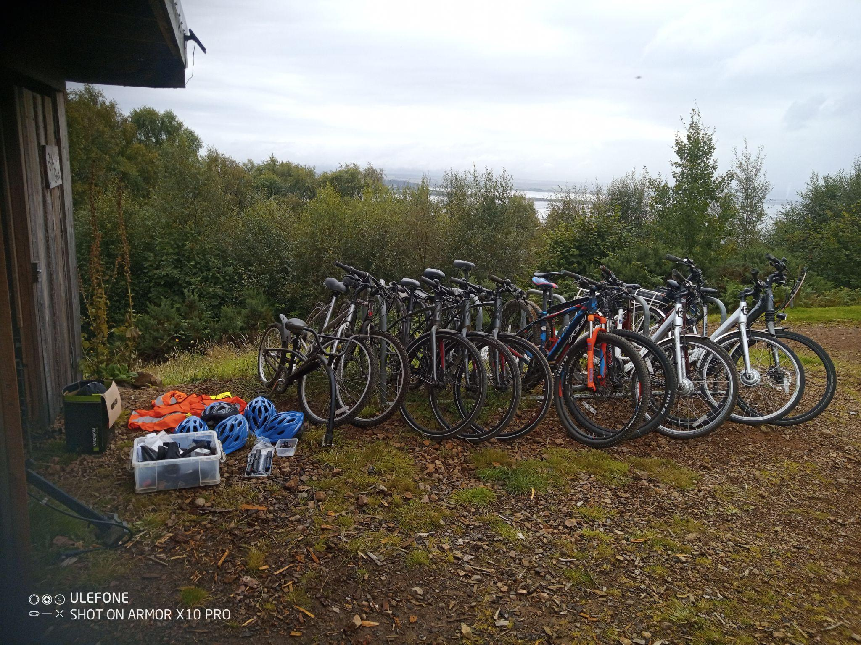
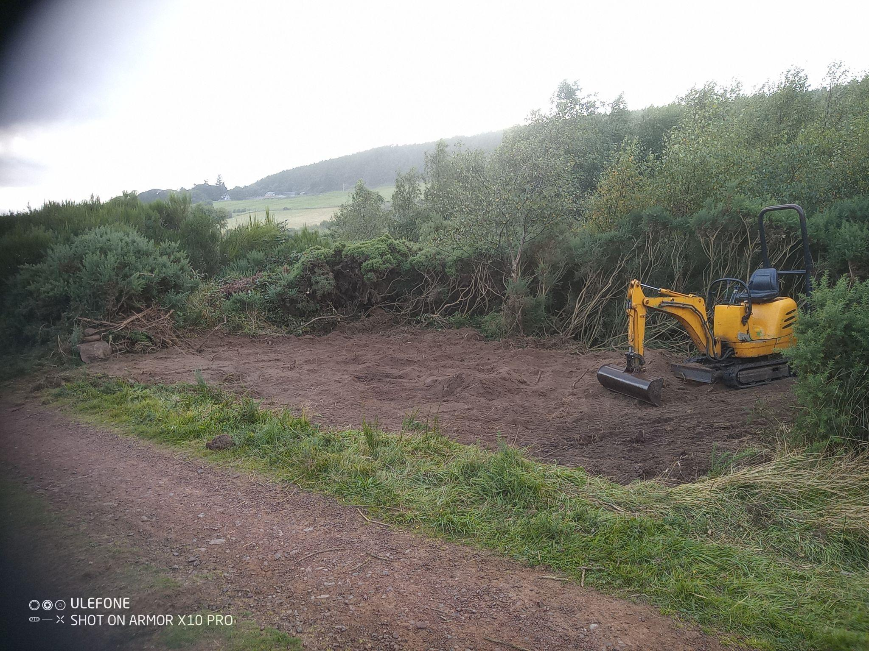
Black Isle Bicycles
Black Isle Bikes has provided a hire service with local community and small business partners over the last 10 years. Hope to have storage organised for continued bike hire at Hillockhead (see photo of ground being prepared) and a Bike Library at Black Isle Leisure Centre as part of our library of things.

Slide 12
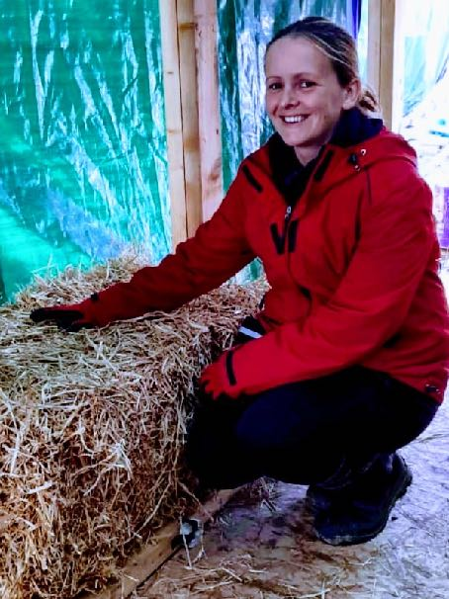
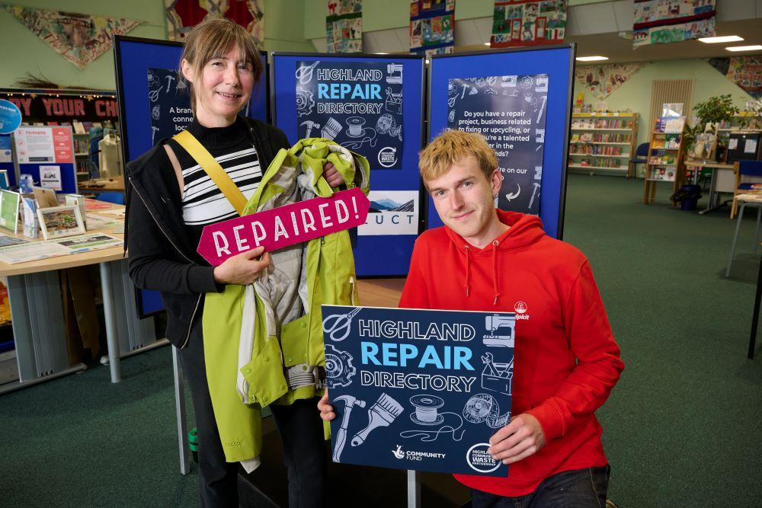
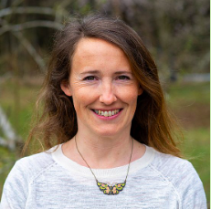
Highland Community Waste Partnership
Laura Donnelly
Rose
TBI is one of eight community groups involved in this 3 year project which ends in March
Project Officer Laura Donnelly. Thanks also to Lyn McLardy who has now left us to join the staff of Flourish.
TBI Trustee line managing/organising Rose Grant
Lyn McLardy

Slide 13
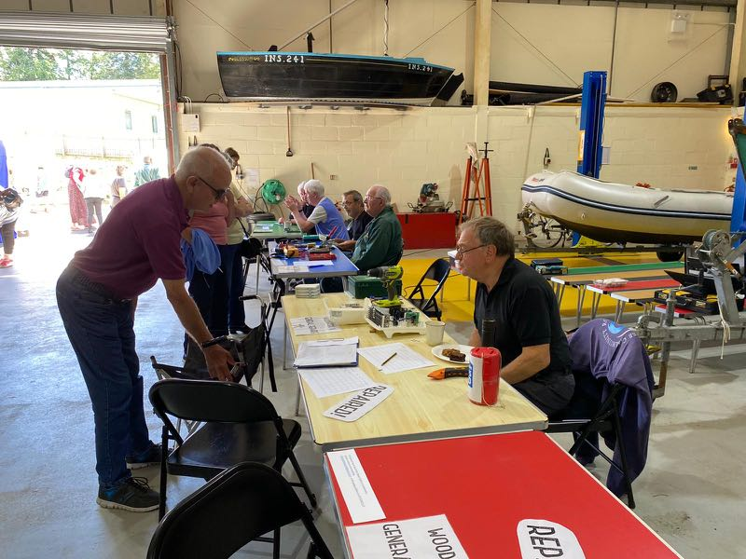

Highland Community Waste Partnership
Repair Cafes
Monthly in different villages
Donations for repairs
Paid organiser now appointed.
Self funding model for the future, similar to markets
Notes:
Much of this on hold but community larders now in place in many Black Isle villages.

Slide 14



Strategies for the Black Isle
Inner Moray Firth Local Development Plan - Greener
Black Isle Partnership strategy - Localism
Black Isle Tourism strategy - Slow Tourism
The Transition agenda is slowly becoming mainstream
In 2023 a community-led Place Plan for the Black Isle was developed for Highland Council and the Scottish Government with Transition Black Isle as a community member. This has now been adopted by Highland Council

Slide 15
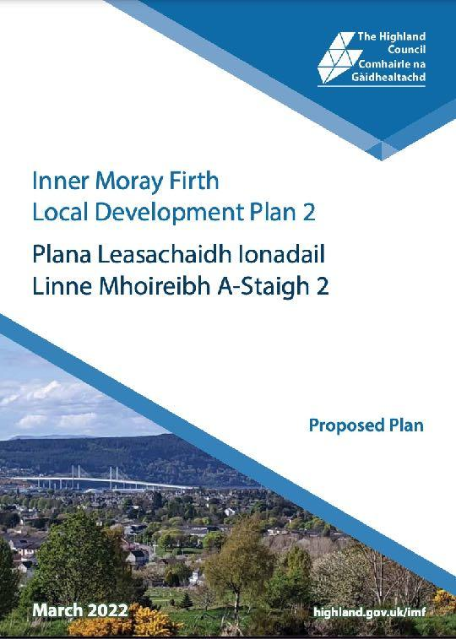
Local and National Consultations
                Inner Moray Firth Local Development Plan 2
Active Travel Masterplans for the Inner Moray Firth
Forest and Land Scotland - access to Black Isle estate
John o’ Groats Trail
                Net Zero Britain

Slide 16
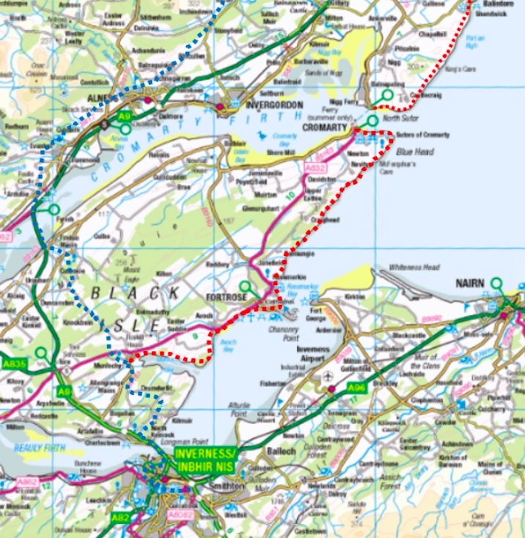
Black Isle Coastal Trail?
                We’ve been supporting the John o Groats Trail folk over the years and they are hoping to develop a Black Isle Coastal Trail which would link up with the Cromarty Ferry. Questionnaire here

Slide 17
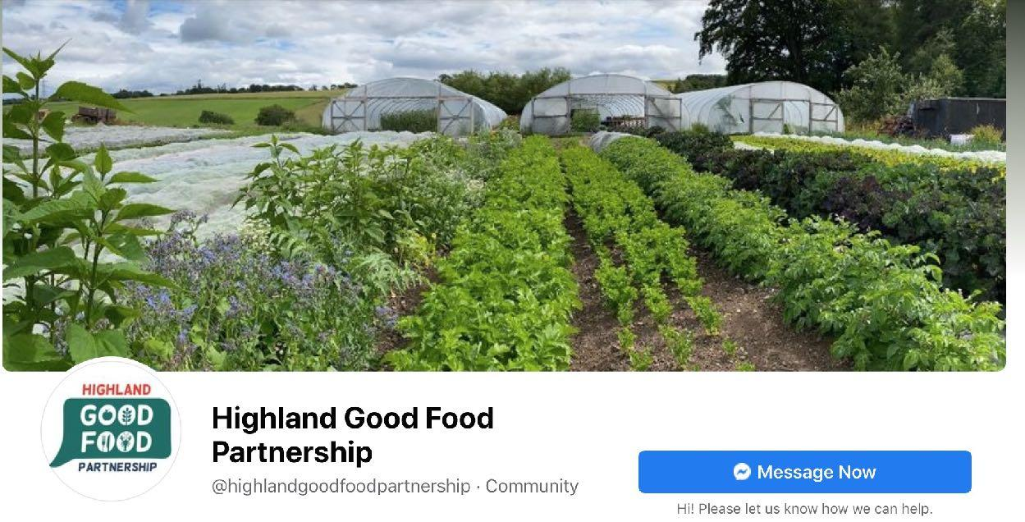
Highland Good Food Partnership
Transition Black Isle was an original sponsor with The Pebble Trust of the Highland Good Food Partnership.
Now HGFP is more high profile than we are.

Slide 18
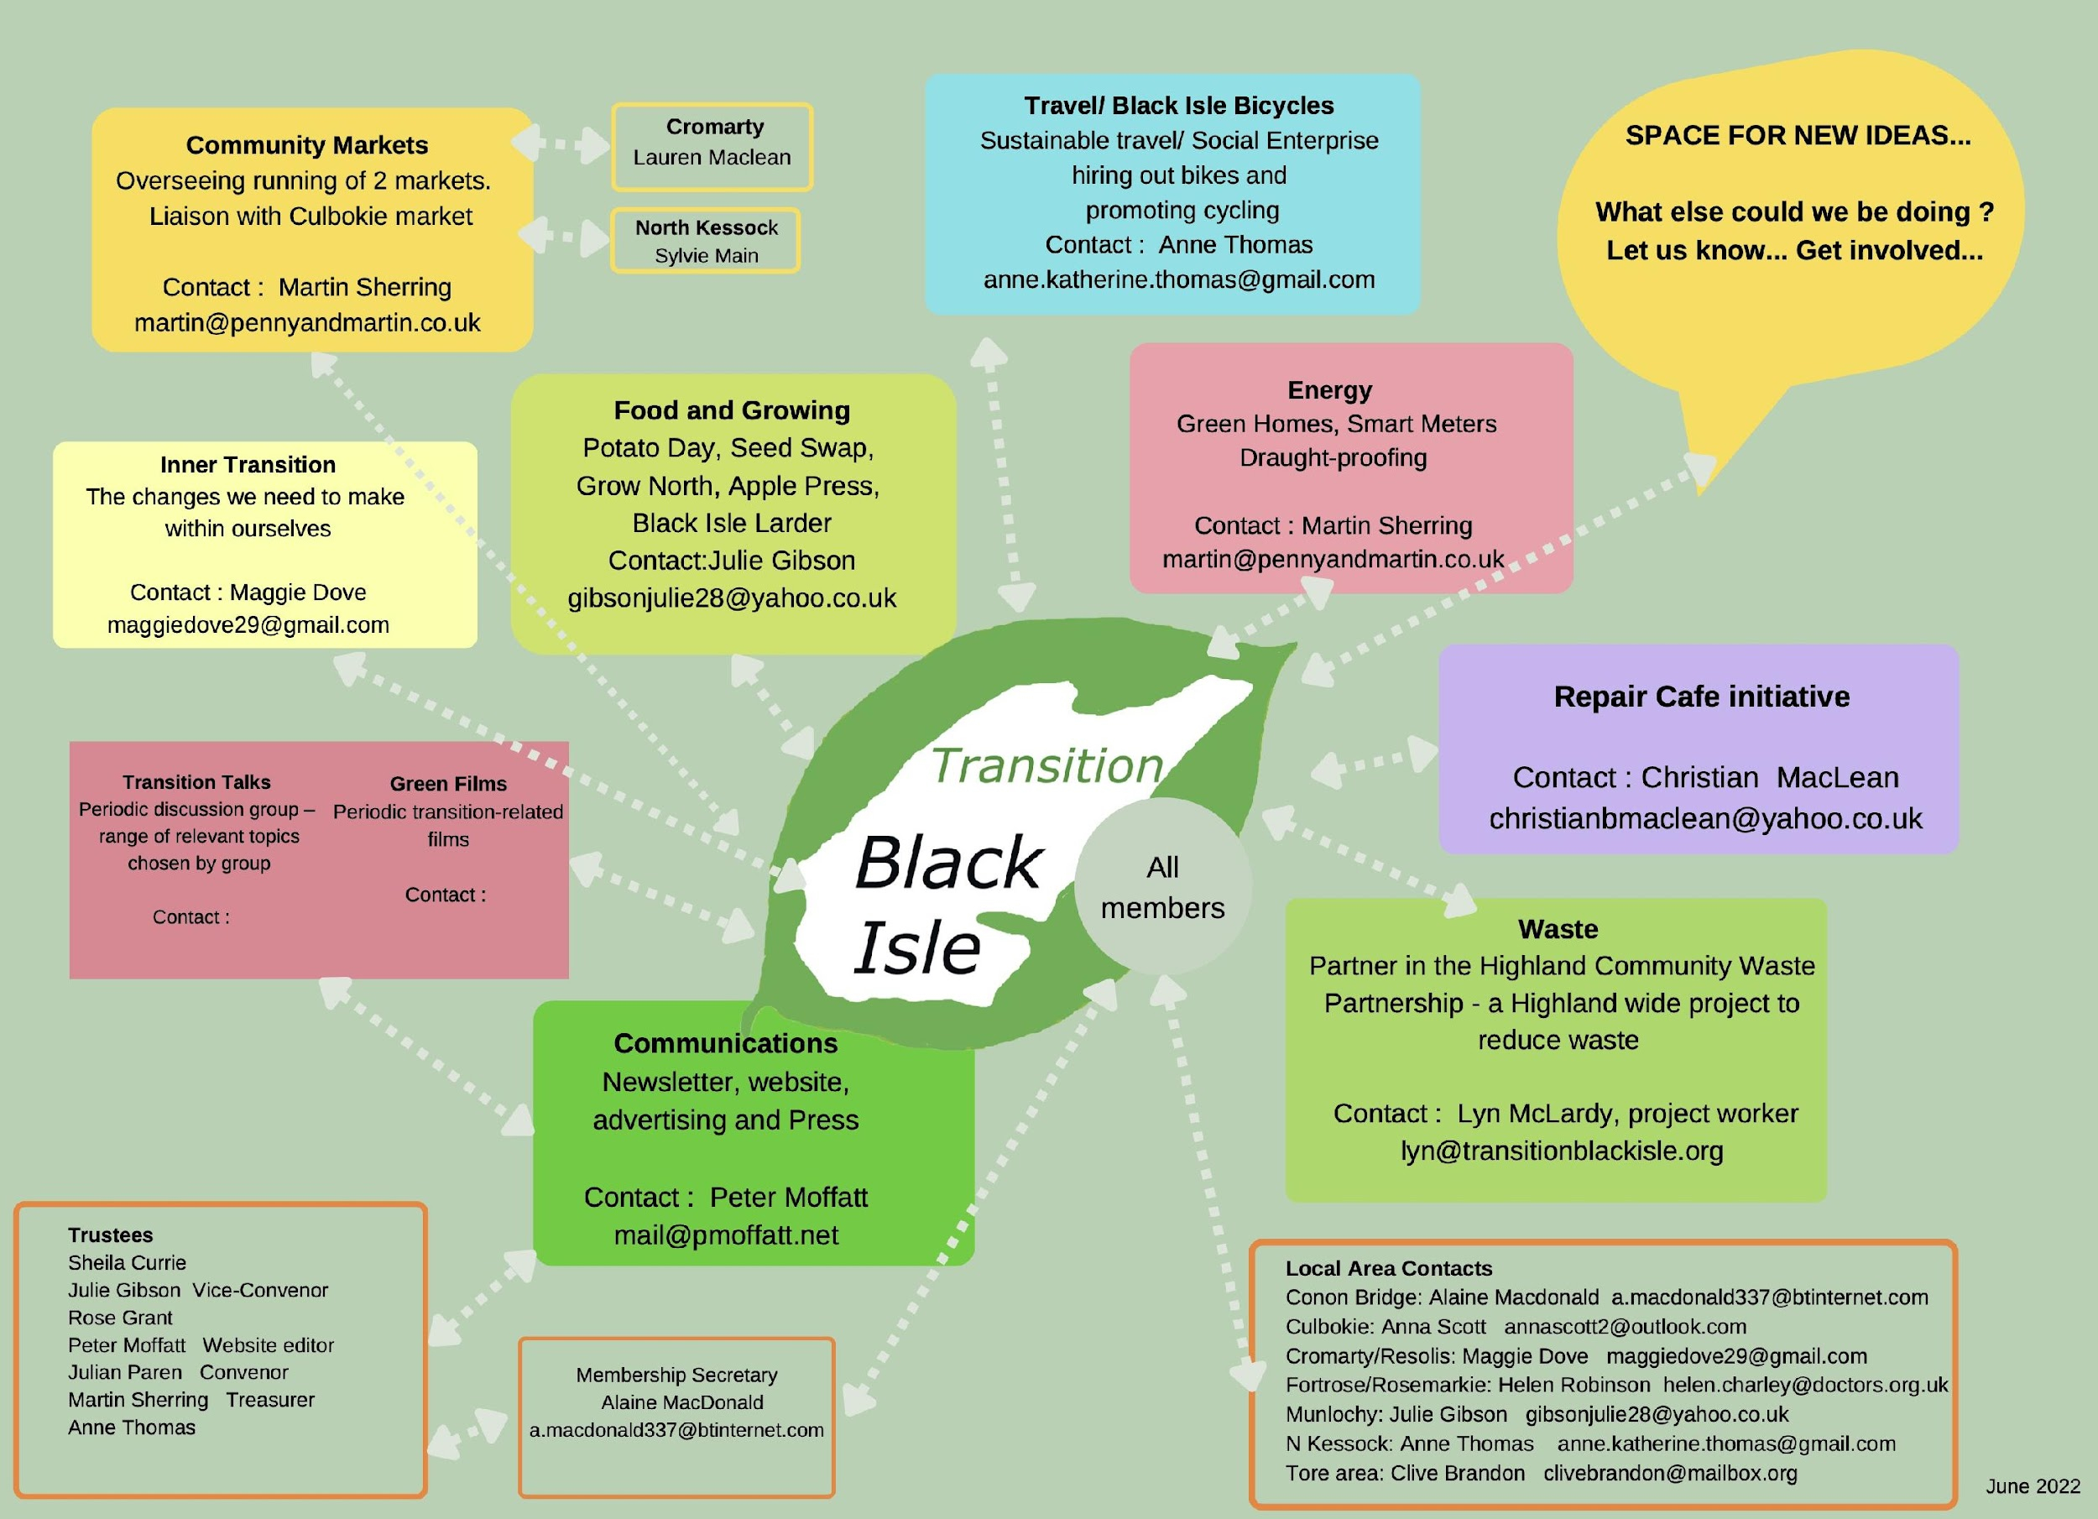
The organisation of TBI
Who does what?

Slide 19
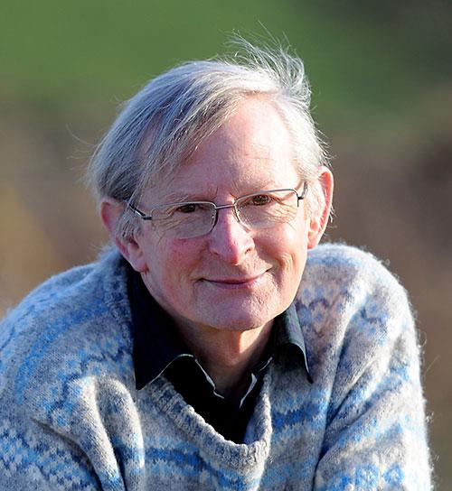
TBI Trustee retirement of Julian Paren
Julian is a very long standing member of TBI and has devoted much time to it over the last 15 years. He came to the first meeting and became involved soon after he and Mary moved up from Cambridge.
Initially he was still running an online International climate change course under the auspices of Cambridge University following a career in glaciology with the British Antarctic survey and we are grateful for his knowledge and wisdom which he has shared in formal talks on several occasions He has been both Convenor and Treasurer, both key roles.
He has provided a great source of inspiration to all Trustees.
We are hopeful he will still contribute in many ways
Notes:
.

Slide 20
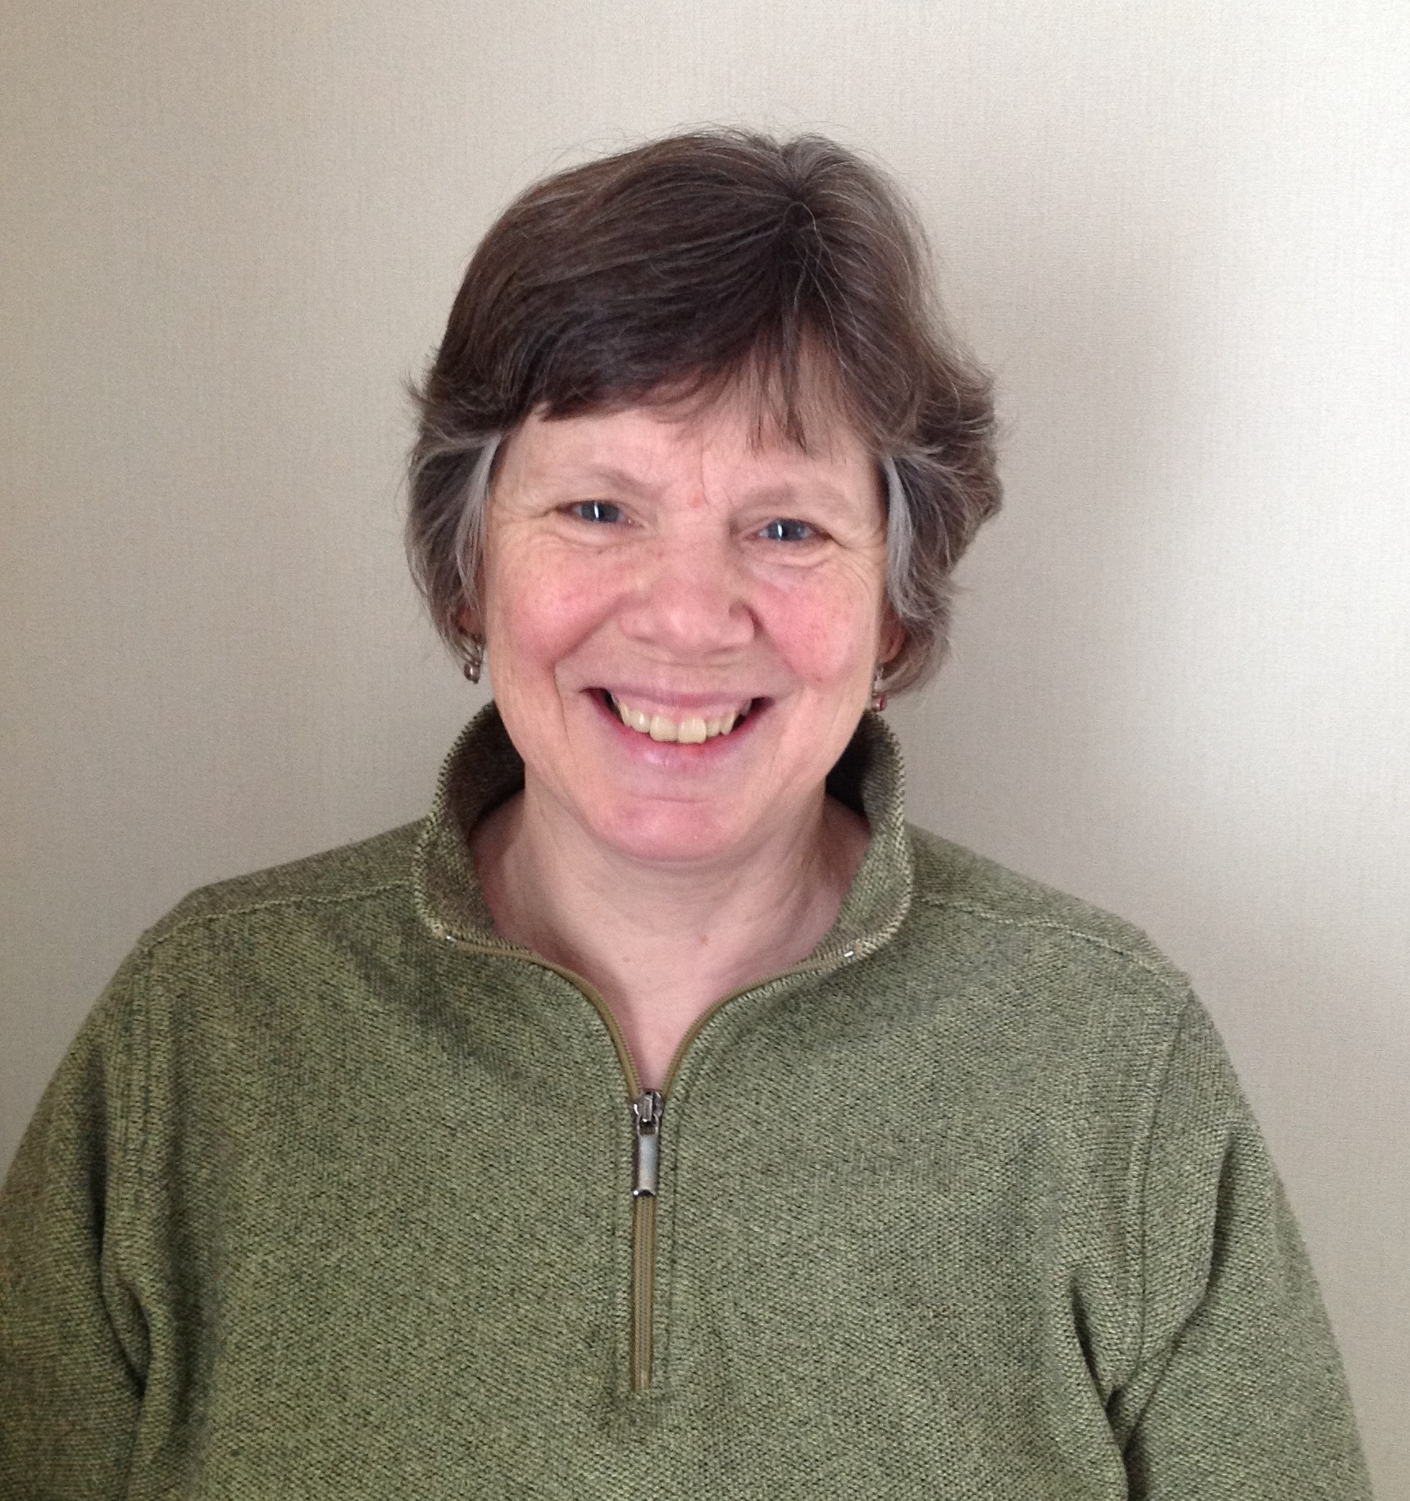
TBI Trustee retirement of Julie Gibson
Julie has been a TBI Trustee for about 10 years including the roles of Convenor and Treasurer. Her professional background was in careers guidance in Kent. She also pursued an interest in spirituality.
An Earth Literacy course at Genesis Farm, New Jersey, was a wake up call to what is happening to our planet and since then she has been trying to live out the implications of that. She first heard of Transition Towns there.
Originally from Inverness she moved back north, to Munlochy created a vegetable and fruit garden and energy efficient house. She will continue to chair the Food Group.

Slide 21
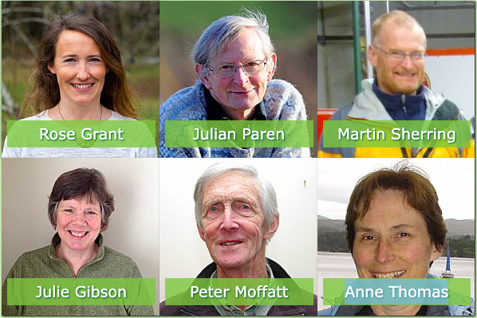
Goodbye to Julian and Julie as a Trustees
Six Trustees are involved with different local and national groups.
2 will step down this year and 2 more join
All members need to spread the message of Transition in their daily lives
Could you join us?

Slide 22
Death of ‘Agric’
We are sorry to share the sad news of the death of one of our founder members ‘Agric Hadron’. This was more of a pen name for John Church. His brother Stephen let us know. He died on 3rd September from heart related issues. He was the main driver of our very successful Potato day and incredibly knowledgeable on the subject as he was on many other issues. He served as webmanger and treasurer, helped set up Culbokie Community Garden and polytunnel at Netherton, which now functions more like an allotment and helped with our Grow North Course. He moved South to look after elderly parents a few years ago. Some of his posts are still up on our website forum. Sadly many of his predictions, which some felt overly gloomy have come to pass
Frodo’s Solution was particularly memorable.
Agric leads a Grow North Session at Culbokie Community Garden polytunnel

Slide 23
Transition Black Isle AGM November 2024
Convenor’s Report – Anne Thomas/ Rose Grant
From The Transition Companion by Rob Hopkins
If we wait for governments to act, it will be too little, too late
If we act as individuals, it’ll be too little
But if we act as communities, it just might be enough, just in time
Notes:
BI

